Slide 1
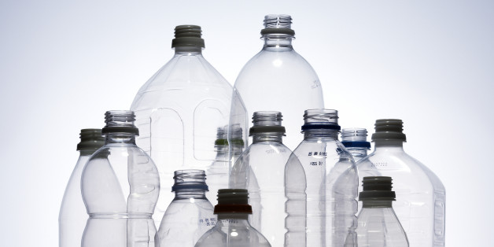
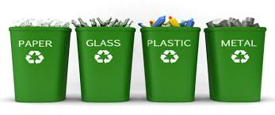
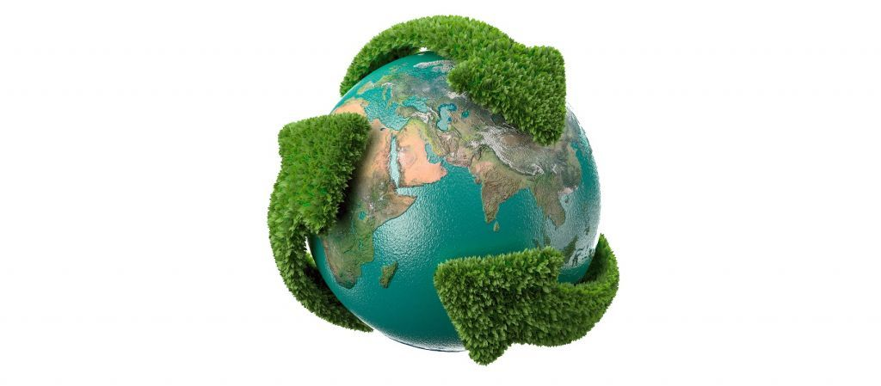
WORLD WITHOUT WASTE
The Coca-Cola Company
DESIGN
100% recyclable primary packaging by 2025
50% recycled content in packaging by 2030
All primary packaging in TH is already 100% recyclable.
Working with aurthorities to introduce bottles w recyled PET .
COLLECT
Collect & recycle equivalence of 100%
primary consumer packaging sold by 2030
Engaging with industry partners to combine efforts in addressing the challenge.
PARTNER
Partnership to support healthy
debris-free environment (land & sea)
Supporting partnership programs that helps promote recycling and tackle marine debris issue.

Slide 2
Flow of post-consumer packaging*
3. Upcycling/ Use of
recycled materials
Collected as clean stream (as segregated materials)
Collected as a higher value stream
Amount entering
junk shops
Collected as a lower
value stream
1. Source Segregation
Packaging put in market for consumer use
Collected as contaminated stream
(as mixed)
Sent to landfill/ incinerators
Stays at Landfill
2. Law Enforcement/
Improved coverage
4. Waste stream
interception
Not collected
Environment Leakage – Litter to waterways/ open dump sites
* Taken from “Material Flow and Value Chain Analysis for PET Bottles & Aluminium Cans in Thailand” by Gone Adventurin, 2018

