Slide 1
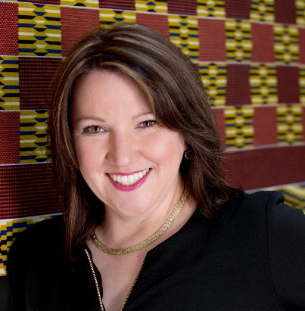
The New Plastics Paradigm
Beyond 3Rs to the Circular Economy
Trish Hyde MD, The Plastics Circle Plasticity Director Founder PlastX

Slide 2
Plastic and
the Environment
Basics

Slide 3
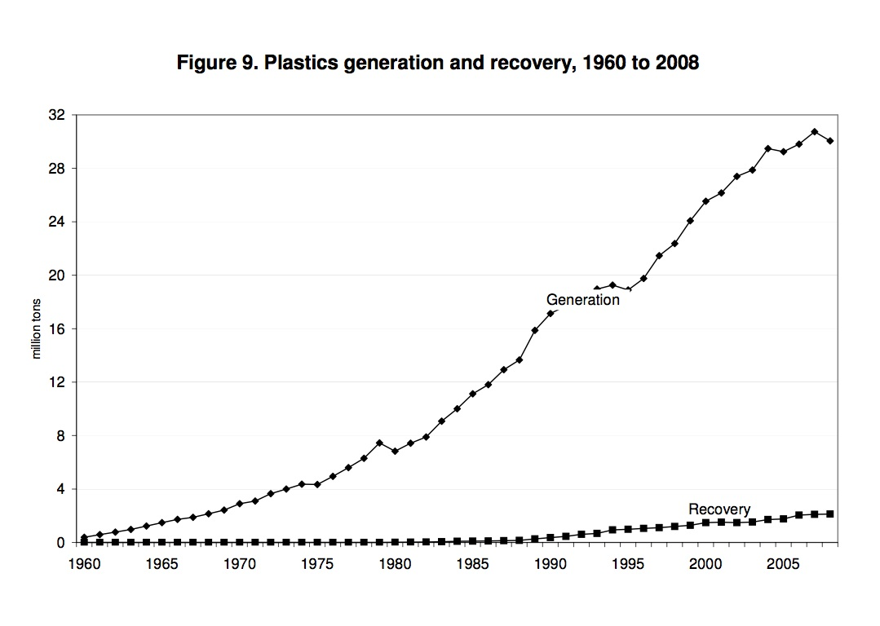
Plastics Generation and Recovery – 1960 to 2008
Generation Growth
The Chasm
Recovery Growth
Source: Waste Atlas

Slide 4
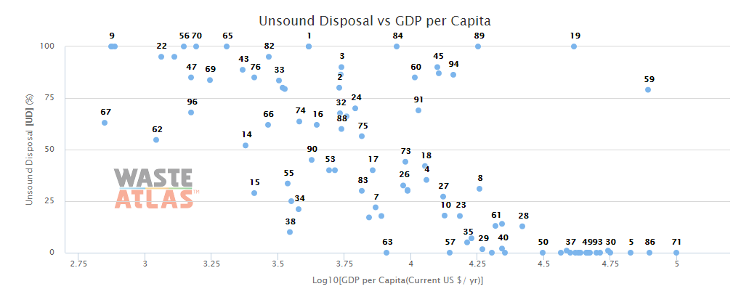
Unsound Disposal
Macao
Albania, Algeria, Angola, Bangladesh, Belize, Benin, Brunei, Burundi, Cameroon, Egypt, Guatemala, Haiti, Honduras, Hungary, India, Jamaica, Laos, Macao, Malaysia, Moldovia, Nicaragua, Nigeria, Pakistan, Philippines, Sri Lanka, Suriname, Syria, Trinidad & Tobago, Uruguay, Venezuela

Slide 5
Plastic Waste
Rivers:
Niger – Nile – Indus – Ganges – Mekong – Pearl – Yangtze – Yellow – Hai He - Amur
North Atlantic - South Atlantic – Indian Ocean – North Pacific – South Pacific
Gyres

Slide 6
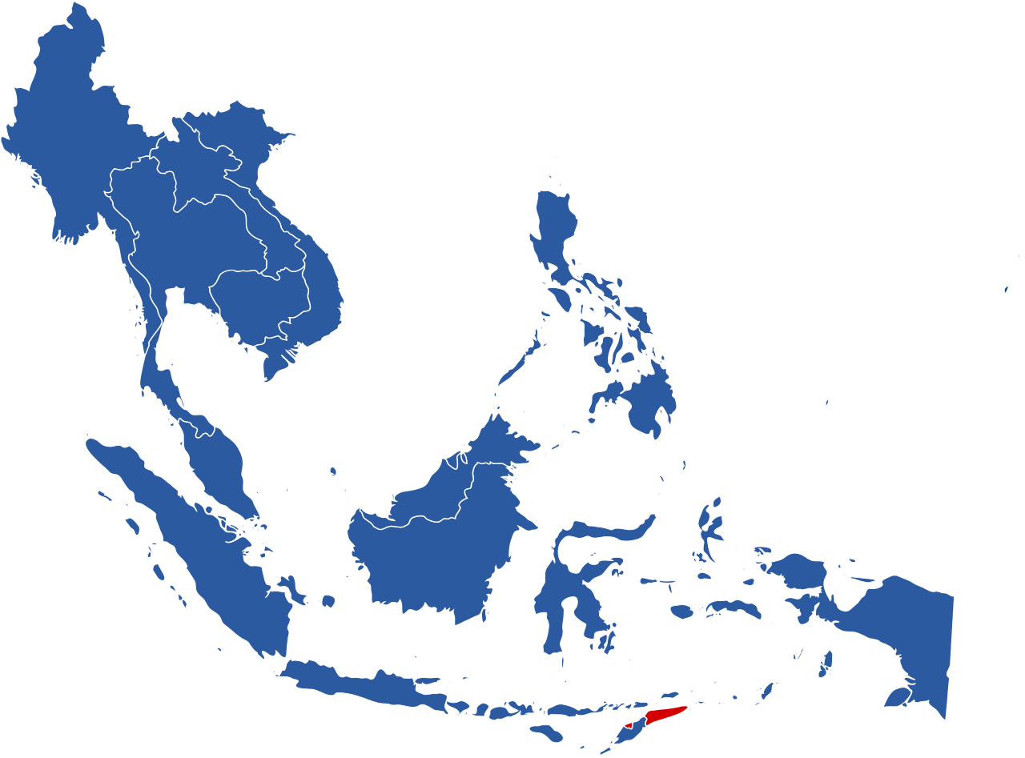
Today
Global Waste Output (2.2bn tons)
would cover ASEAN
75cm deep
This Photo by Unknown Author is licensed under CC BY-SA

Slide 7
By 2050 the
Global Waste Output
would cover ASEAN
125cm deep

Slide 8
Rivers carrying plastic to the ocean are in Asia

Slide 9
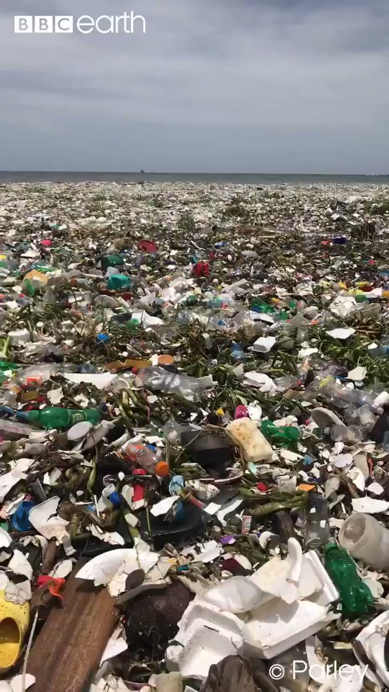
Waves of Plastic
Dominican Republic
19 July 2018

Slide 10
Plastic Circularity
The Future

Slide 11
Plastic as a Resource
 | Part of the value chain | Resources optimised | Waste elimination | More
Resource Efficiency | Manufacturing
Cradle to Cradle | Manufacturing
Circular Economy | Whole
Circularity | Whole

Slide 12
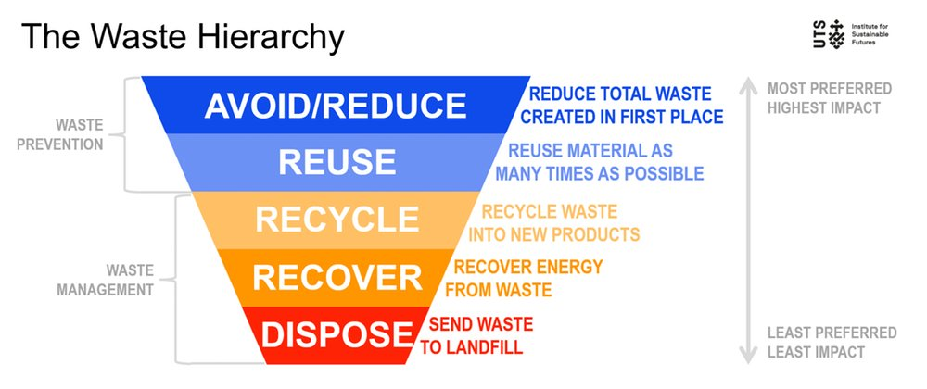
3Rs - Reduce, Reuse, Recyle

Slide 13
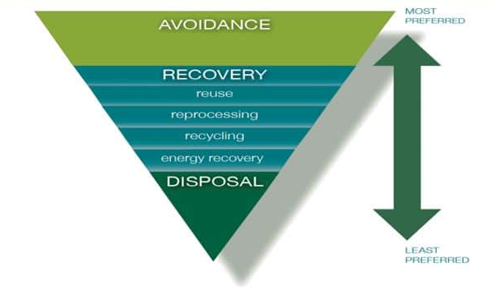
3Rs - Reduce, Reuse, Recyle

Slide 14
Recyclable Plastic Definition
is collected for recycling
has market value / legislatively mandated program
is sorted and aggregated into defined streams for recycling
must be able to be processed and reclaimed or recycled with a commercial recycling process and it must become a raw material that is used in the production of a new product.
Under this definition, innovative materials must demonstrate:
they can be collected and sorted in sufficient quantities, and
they are compatible with the existing industrial recycling processes or will be in scale to justify new recycling processes.
Association of Plastic Recyclers (APR) and Plastics Recycling Europe (PRE)

Slide 15
The Plastic Circular Economy is broken
The Supply Driven Circular Economy
(the vicious circle)
1
Not always designed for recovery
Limited 2nd-life market demand to drive design and recovery.
(<90% of plastic waste
gets a 2nd-life)
3
Make
2nd Life
Limited recovery facilities to collect for 2nd-life market needs
(only a fraction of plastic waste is collected)
Collect
2

Slide 16
Fixing the market failures!
The Balanced Circular Economy
(the virtuous circle)
2
1
2nd-life market demand drives design and recovery efforts
Design uses recovered
content creating more
2nd-life markets
Make
2nd Life
Collect
3
Recovery is a market enabler driving best practice design and feeding 2nd-life markets

Slide 17
Plastic Circularity
In Practice

Slide 18
Recovery and Recovered Design

Slide 19
Brands commitment
Including
Asda Coca-Cola Cranswick Danone Marks & Spencer (M&S) Nestlé Novamont PepsiCo Proctor & Gamble (P&G) Sainsbury’s Tesco Unilever Waitrose.
Committed to
100% plastic packaging reusable, recyclable or compostable
70% plastic packaging effectively recycled or composted
30% (ave) recycled content across all plastic packaging
Opportunity
Challenge
Reputation boost
Stakeholder relations boost
Profit increase
Destiny ownership
Global infrastructure
Recovered-content
Consumer confusion
Regulation

Slide 20
Value Recovery as an Enabler

Slide 21
1.PlastX: Asian Startup
Trading platform to buy the plastic you want directly from the communities where it lands
Quality Traceable
Sustainable Trade
Fulfils Commitment

Slide 22
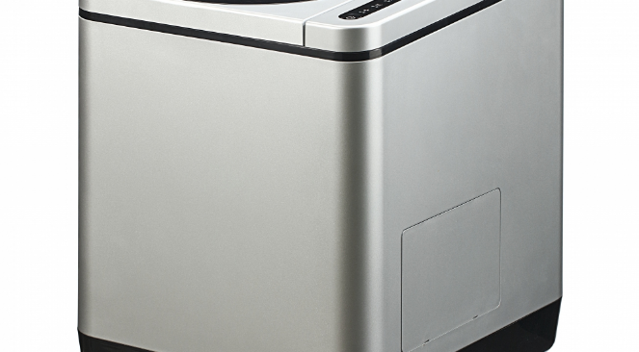
2.Bio24: Asian Startup

Slide 23
New models
Opportunity
Challenge
Deliver on promise
Make a visible difference
Enable brand stories
Overcome lack of infrastructure
Corruption / Mafia-style collection networks
Infrastructure for the last mile (PET)
Investors / competitor inertia

Slide 24
2nd-life Market Demand

Slide 25
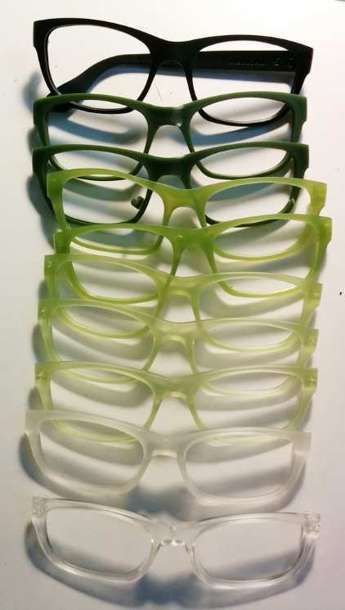
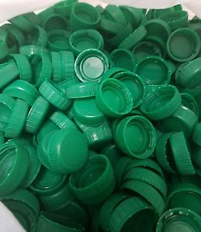
Dresden eyewear

Slide 26
New Market for PCP
Example only

Slide 27
New Markets
Opportunity
Challenge
USD $230B market
Consumer desire
Quality supply at fair price
Investors

Slide 28
Tools / Resources
Circularity

Slide 29
Rio+20 Earth Summit, Hong Kong, New York, Portugal, Shanghai, London, Dallas, Los Angeles, Sydney - Kuala Lumpur 25 Oct
Focusing on Design, Innovation, Materials and Recycling, for a world without the Plastic Waste Fooptrint

Slide 30
Thank You
Questions?
Trish Hyde Trish.Hyde@ThePlasticsCircle.com
www.ThePlasticsCircle.com
www.Plasticity.Global

