Slide 1
Engaging in Industry Initiatives to End Plastic Waste K. Foerster / S. Russell 28th Asia Plastics Forum 2018
Notes:
1

Slide 2
Global Challenges need Global Answers

Slide 3
World Plastics Council
Mission
To be the global forum for industry leadership, and to accelerate cooperation and alignment that will deliver improved outcomes for the common benefit of the plastics industry, consumers & society.
Our Focus needs to be:
Demonstrate and promote the sustainability of plastics, being part of solutions to environmental & marine pollution

Slide 4
World Plastics Council
Action Plan
Communication and Outreach
Build on current engagement efforts within our Industry, to grow membership and be part of a wider Industry communication process to significantly increase our impact on public opinion through “telling our story”
Sustainability Agenda – Stakeholder Engagement
Drive our sustainability agenda through relationships with key global stakeholders such as UNEP, the G7 and G20, and APEC forums.
Solution Orientated Action
In addition to the ongoing initiatives we sponsor such as Ocean Conservancy and Closed Loop Oceans, we want to actively support member initiatives in the areas of waste management and recycling to be able to address this global issue with locally relevant solutions. We will do this leveraging both best practice and our membership network, building on the Asia Pacific Initiative, led by Exxonmobil and Dow representatives

Slide 5
World Plastics Council
New Members 2018

Slide 6
World Plastics Council
Expanding Resources
Sustainability Lead
Ralph Schneider, Covestro
A Sustainability Lead to drive our agenda and coordinate our global efforts in front of key multi-lateral governmental organization
Communication Lead
Grey Guo, BASF
A Communication Lead, to help develop resources and communication for membership as well as supporting wider external Industry Communication and Outreach

Slide 7
Notes:
Resin suppliers also are organizing themselves with marine debris being the primary driver.
3 years ago these companies formed the WPC as a platform for executive leaders to share insights, develop strategies and leverage investments.
WPC recently incorporated as first step to achieving UN Stakeholder status. That process will take 18-24 months.

Slide 8
Industry prevents Microplastics to Leak into the Environment

Slide 9
Collaboration is Key

Slide 10
Aligning Plastics Associations across the World

Slide 11
Global Plastics Alliance
History
Established | 1990’s
Participation | National/Regional Plastics Associations
Management | ACC/PlasticsEurope
Organization of Meetings | MPMA Kuala Lumpur PPIA Manila CPCIF Yuyao VPA Hanoi 2017 MPMA Penang 2018 INAPLAS Bali

Slide 12
GPA Meeting Objectives
Improve outcomes on global issues
Strenghthen capabilities thru systematic inclusion and support of plastics associations worldwide
Providing participation with access to the global network
Significally strengten the platform for organizing and acting on global opportunities (not replacing existing regional forums)
Primary Focus: Marine Litter Solutions

Slide 13
Agenda
Information
Roundtable Country Reports
Global Activities
Best Practice Sharing:
Plastic Waste Management Strategies
Advocacy Strategies
Communication and Outreach
Responding to Threats and Opportunities
Global Action Team Meetings
Marine Litter Solutions
Waste Data

Slide 14
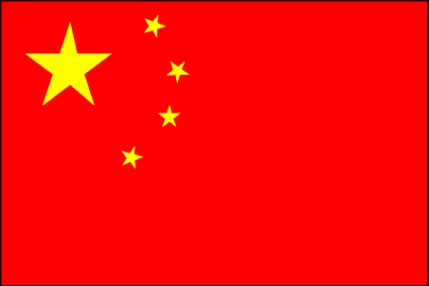
GLOBAL PLASTICS ALLIANCE
2017
2015

Slide 15
POLYTALK 2018
POLYTALK 2018 - MOVIE

Slide 16
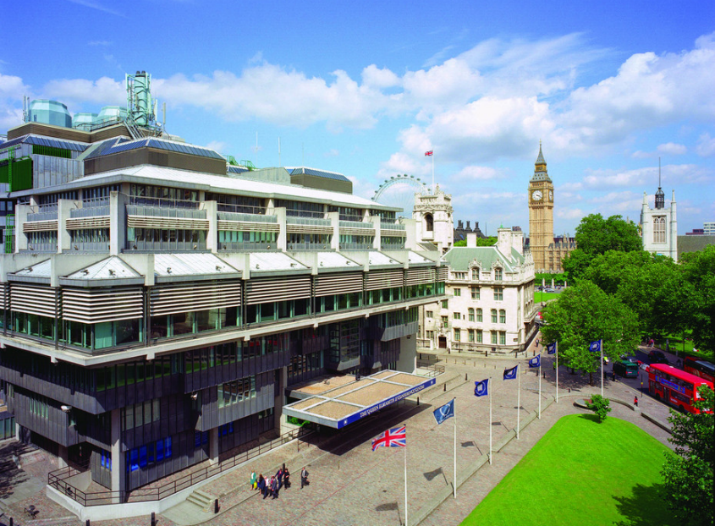
IdentiPlast 2019 - In the Heart of Westminster
IdentiPlast is PlasticsEurope’s international forum to present latest engineering technologies for plastic waste management, exchange best practices, share knowledge and network.
Next edition will be held on 7 & 8 March 2019 in London (UK).
Conference Centre: The Queen Elizabeth II Centre
Networking Dinner:
8, Northumberland Avenue

Slide 17
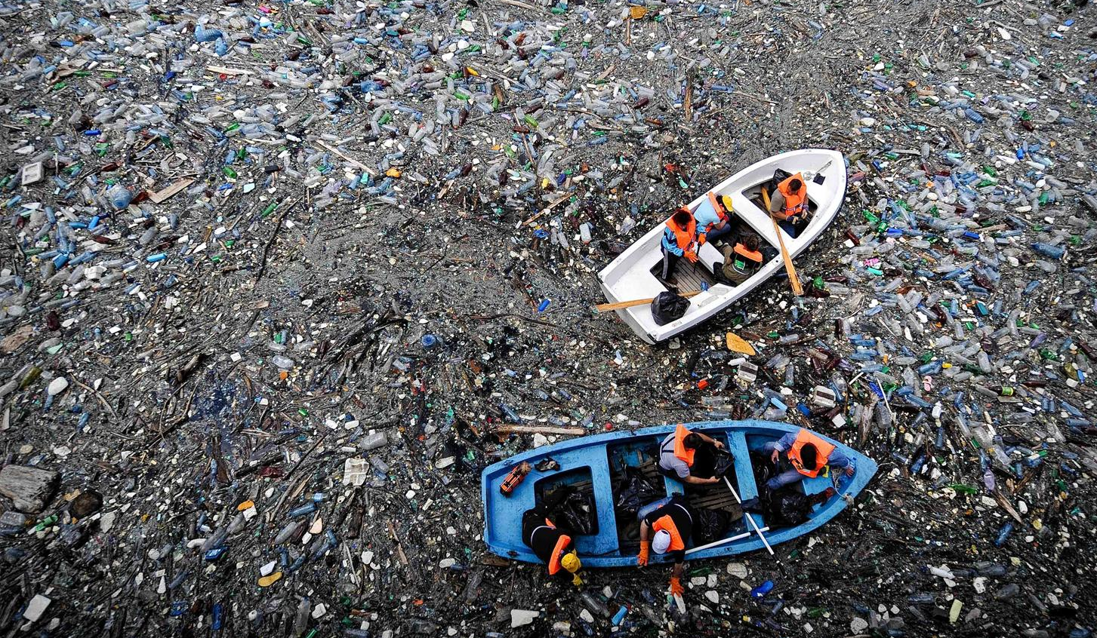
The Asia Plastics Coalition
2018 Asia Plastics Forum update

Slide 18
The Coalition will leverage supply chains to increase the collection of plastics, enable reuse of the material and work to create viable end uses / markets:
Asia Plastics Coalition (APC)
A cross-value chain platform to reduce plastic waste and marine debris in the Asia Pacific region
OBJECTIVES:
Collaborate to identify and implement solutions at scale that facilitate the collection of post-use plastics
Develop innovative solutions for collection, recycling and re-processing technologies and business models
Demonstrate value and economic return to governments and private investors to support the build out of infrastructure in the region
Support required regulatory and cultural change
GLOBAL ALLIANCE
(tbd)
AP COALITION
WBCSD
MEMBERS
OTHER GLOBAL COMPANIES
LOCAL COMPANIES
REGIONAL ASSOCIATIONS
NGOS

Slide 19
Our approach
Coalition Members select projects they would like to fund from a pipeline of recommended projects:
source project ideas
evaluate projects
generate pipeline
confirm project funding
project award
Coalition Members
Shortlist of recommended potential projects issued to Board of Members
Coalition Members and Associates
Project Evaluation Team
Contracts finalized and projects publicly announced
Advisors
Open Request for Proposals
Steering Commitee
Invitation to form APC Project Teams
ESG, Legal and Financial Due Diligence

Slide 20
Attendees of the July 2018 AP Coalition meeting
60+ organizations joined APC discussions in March and July 2018 to help define the Coalition’s mission, objectives, potential governance model, and project selection criteria
Resin Producers | Brands | Packaging & Inks | NGOs / Associations / Financiers / Other
 |  | Waste Management
Notes:
The ASEAN Federation of Plastic Industries (AFPI) is a regional grouping of plastics industrial associations from the ASEAN countries. Presently, the AFPI constitutes of seven members. The Indonesia Olefin, Aromatic & Plastic Industry Association (INAPLAS), the Malaysian Plastics Manufacturers Association (MPMA), the Myanmar Plastics Industries Association (MPIA), the Philippine Plastics Industry Association Inc. (PPIA), the Singapore Plastic Industry Association (SPIA), the Plastic Industry Club c/o Federation of Thai Industries (PIC-FTI) and the Vietnam Plastics Association (VPA). Together they represent a total of more than 3,000 plastic companies.

Slide 21
Initial potential projects
APC Project Teams are currently being formed to advance project plans and cost estimates for three ideas:
City-partnership programs to design, implement and scale effective waste management systems to prevent plastic leakage – target launch of three cities across three high-leakage countries
Information system to improve information about after-use plastic material flows – with an initial focus on developing an open-access database
Reuse of post-use plastics in roads and building materials

Slide 22
Where are we at…
The mission of the AP Coalition is widely supported; however appropriate questions are being raised about how the APC should be established and governed to support cost-efficiency and communications clarity
We are working on formalizing a relationship with this expanded global alliance, with an eye towards capturing the value of such a relationship for the AP Coalition
This approach will focus on ensuring that fees remain low, or further reduced, to enable maximum participation of local companies and groups to join our efforts

Slide 23
APC next steps and timeline
OCTOBER
Early October: Project Team introductory calls
Finalize name and launch plans
Late October: Public announcement at WBCSD Council Meeting (Singapore) and Our Ocean 2018 Bali Conference
Thursday October 25th: APC meeting (Singapore) – to discuss updated Operating Model; Project Team meetings
DECEMBER
Target date for launce of first projects awarded through the APC
2018
SEPTEMBER
Confirmation of governance processes between Alliance, AP Coalition, WBCSD
APC ‘Participation Statements’ to be issued and completed by interested organizations
Formation of Project Teams
NOVEMBER
Target date for first public Request for Proposals (RFP) for project ideas

Slide 24
How to participate
To receive further information, communicate your interest to your local plastics association (e.g. Plastic Industry Club, FTI) and the APC Working Group
If your organization would like to join a Project Team (to advance planning for one of the three project ideas presented), submit a Project Team Nomination Form by Friday 28th September
Confirm your interest and availability to join the next in-person meeting of the APC on Thursday 25th October in Singapore

